Slide 1

Authorized Channel Partnership Opportunity
With Moon Computer Training Center

Slide 2
About Moon Computer Training Center
Skillz + Revolution = Skill Realization + Industry Gap Bridging
Tagline: “Revolutionizing Skills Acquisition”
Mission: Revolutionize tech skill development for professionals & businesses

Slide 3

Our Signature Programs
Data Science & Analytics
AI & Machine Learning
Generative AI
Cyber Security

Slide 4

Why Partner with Moon Computer Training CENTRE?
High-growth model with zero risk
Up to 30% revenue share
Pre-made marketing & branding tools
Global brand support with local impact
Leadership & digital marketing empowerment

Slide 5
Exclusive Partner Benefits
₹50,000 Introductory Offer (GST applicable)
Technical & IT Infra support
Zero overheads
Lifetime access to resources
Handcrafted scalable programs
Global certifications (NASSCOM)
1-month onboarding support
Digital presence building

Slide 6

Key Delivery Features
1
Industry-focused curriculum
2
For IT & non-IT professionals
3
Live, interactive, 2-way online classes
4
Industry-focused curriculum
5
For IT & non-IT professionals
6
Live, interactive, 2-way online classes

Slide 7

Certifications & Career Empowerment
Globally recognized, QR-verifiable certificates
NASSCOM Gold Certification
Post-assessment interview scheduling
LinkedIn, GitHub, Kaggle profile building
Separate Project Certificates

Slide 8


Slide 9

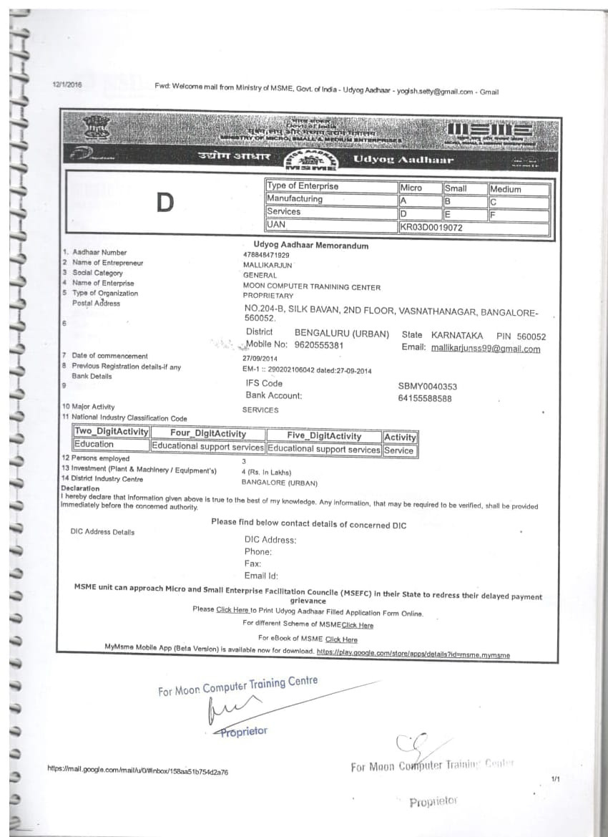

Slide 10

Join Us – Let’s Empower Together!
“Limited partner slots available!”
Invite to a Virtual Meet for detailed discussion
Contact details: Email, phone, and website (if any)

